Slide 1

Requirements-Driven Online Adaptation to Mitigate Runtime Uncertainty for AUSs
Yixing Luo
yixingluo@pku.edu.cn
Software Engineering Institute
School of EE & CS, Peking University

Slide 2
CONTENT
1
Introduction
目录
2
AUS Modeling
3
Approach
4
Experimental Evaluation
5
Related Work
6
Conclusions and Future work

Slide 3
1
Introduction

Slide 4
Introduction
Autonomous Unmanned Systems (AUSs)
Exciting application: e.g., unmanned ground vehicles, unmanned aerial vehicles, and unmanned underwater vehicles
Control software system, which is responsible to control the motion of AUSs to complete given tasks, as well as satisfying different requirements
Runtime Uncertainties
The operating environment might be highly dynamic and unpredictable;
The multiple requirements might conflict with each other;
The system parameters (e.g. energy consumption and sensor accuracy) might change over time
The effects produced by these sources of uncertainty can compound and thereby inhibit the system from fully satisfying its requirements.

Slide 5
Introduction
Self-adaptive mechanism
To guarantee the system is robust in the face of dynamic behaviors, control theory provides the possibility for designing robust adaptive systems that operate with formal guarantees, so that desired properties can be guaranteed by designed.
Ad-hoc —— general and automated methods:
SimCA[2], SimCA*[14], AMOCS-MA[1]
Limitations with current control-based self-adaptation mechanism
Optimality: seldom deal with trade-offs between goals —— focus on using predefined priorities to maximizing the satisfaction of multiple goals
Efficiency: reduce adaptation space
number of goals to optimize, exponential configuration space

Slide 6
Proposed Method
Control-based goal adaptation mechanism (Captain)
Autonomously detect and minimize of goal violations to ensure optimal goal satisfaction in response of runtime uncertainties.
Goal Satisfaction Checking: to check whether all the goals can be achieved in the immediate future based on a goal satisfaction model established at design time.
Goal Violation Analysis: evaluates their satisfaction degrees and divides the goal set into two subsets: violated and non-violated goals. If the violated goal set is none, a feasible solution can be found such that all goals can be achieved under current situation.
Goal Satisfaction Optimization: transforms violated goals into objective functions and optimize their satisfaction by adjusting the expectation to enlarge the search domain, while non-violated goals are maintained as constraints to guarantee.

Slide 7
Proposed Method
Contributions:
(1) We formalize the behavior model and requirement model for AUSs. In particular, the requirements are classified into three categories i.e., task, hard constraints and soft goals based on their characteristics and differential expectation of their satisfaction.
(2) We propose a real-time requirement evaluation approach to detect goal violations and evaluate their degree of violation based on a goal satisfaction model. In particular, goal satisfaction is checked and analyzed proactively, such that actions are taken to minimize such violation in advance of accidents.
(3) We propose real-time and multi-objective planner which allows sensor reconfiguration and motion planning of AUSs simultaneously.
(4) We conduct comprehensive experimental study of Captain in both simulators and real systems, using various AUSs, to evaluate the effectiveness and efficiency of our approach. Promising results have been shown that Captain can improve adaptation flexibility and optimal goal satisfaction with acceptable performance overhead.

Slide 8
2
AUS Modeling

Slide 9
Motivating Scenario
Exciting applications for UAV
Since Amazon announced its drone delivery plan “Amazon Prime Air” in December 2013, drone delivery starts its countdown on the commercial usages.
Alphabet's Wing launched its inaugural commercial drone air delivery trial in October 2019 and become the first company to provide drone delivery services in United States.
Challenge:
It is challenging to balance different goals at design time, since these goals may conflict with each other due to changes and uncertainties in the environment and the system.
Trade-off between timeliness/energy-saving and privacy-preserving
Energy-saving and safety landing condition
due to changes of environments and system capacities, dynamic goal balance is required

Slide 10
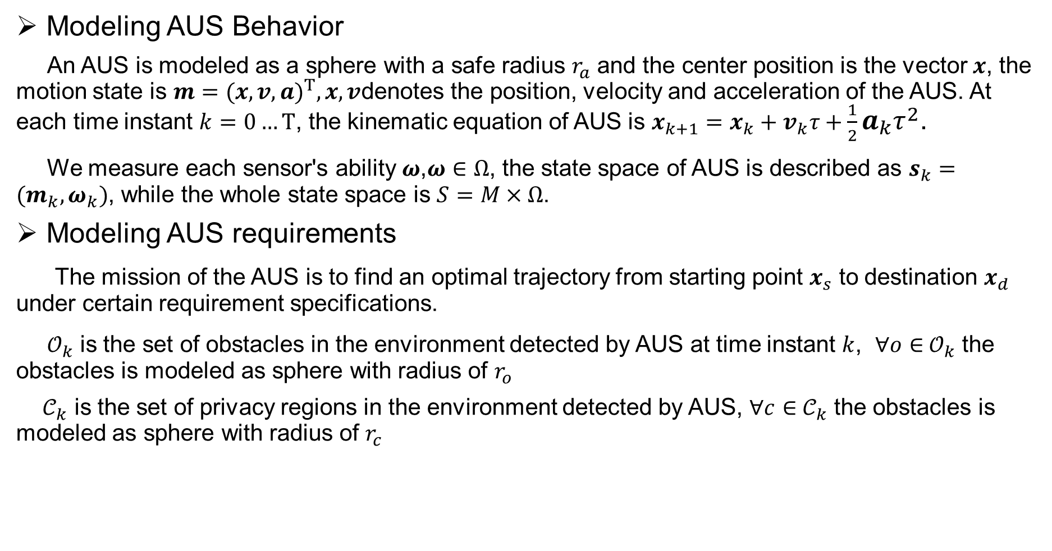
System and Environment Modeling
Modeling AUS Behavior
An AUS is modeled as a sphere with a safe radius $r_{a}$ and the center position is the vector $x$, the motion state is $m={(x,v,a)}^{T},x,v$denotes the position, velocity and acceleration of the AUS. At each time instant $k=0…T$, the kinematic equation of AUS is $x_{k+1}=x_{k}+v_{k}τ+\frac{1}{2}a_{k}τ^{2}$.
We measure each sensor's ability $ω$,$ω∈Ω$, the state space of AUS is described as $s_{k}=(m_{k},ω_{k})$, while the whole state space is $S=M×Ω$.
Modeling AUS requirements
The mission of the AUS is to find an optimal trajectory from starting point $x_{s}$ to destination $x_{d}$ under certain requirement specifications.
$𝒪_{k}$ is the set of obstacles in the environment detected by AUS at time instant $k$, $∀o∈$ $𝒪_{k}$ the obstacles is modeled as sphere with radius of $r_{o}$
$𝒞_{k}$ is the set of privacy regions in the environment detected by AUS, $∀c∈$ $𝒞_{k}$ the obstacles is modeled as sphere with radius of $r_{c}$

Slide 11
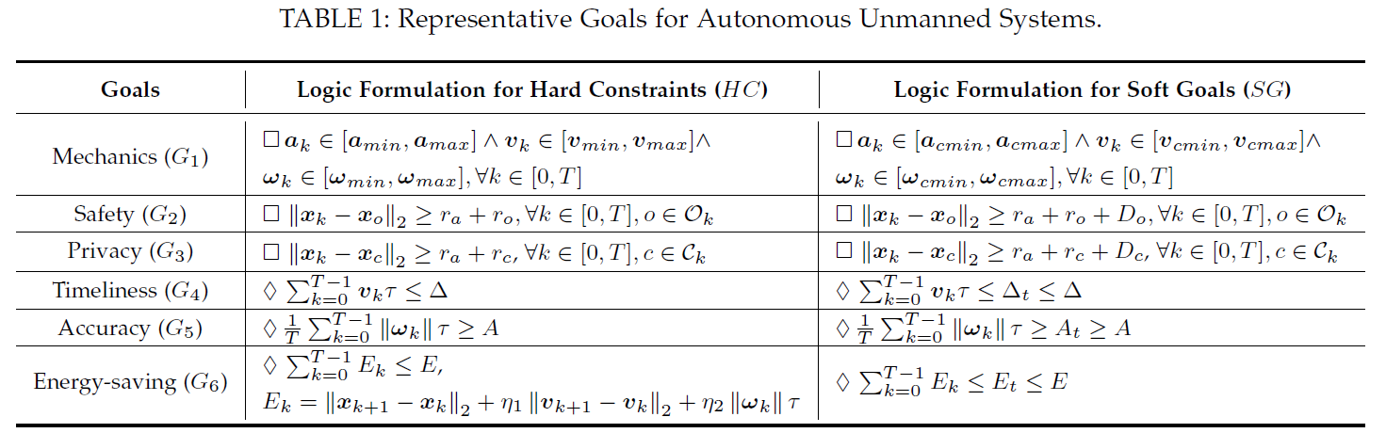
Modeling AUS requirements

Slide 12
System and Environment Modeling
Problem Statement
To guarantee the optimal satisfaction of multiple goals, and figure out appropriate the motion plans and sensor configurations of an AUS efficiently, regardless of runtime uncertainties, i.e., fluctuations in the system parameters, requirements variations and dynamics in the environment. Specifically, the system should identify the follow questions:
When will the AUS fail to achieve all the goals due to runtime uncertainties?
Which goals are predicted to be violated?
(3) How should the AUS improve the satisfaction of goals assumed to be violated while meeting the other goals via real-time behavioral adaptation of AUSs?

Slide 13
3
Approach

Slide 14
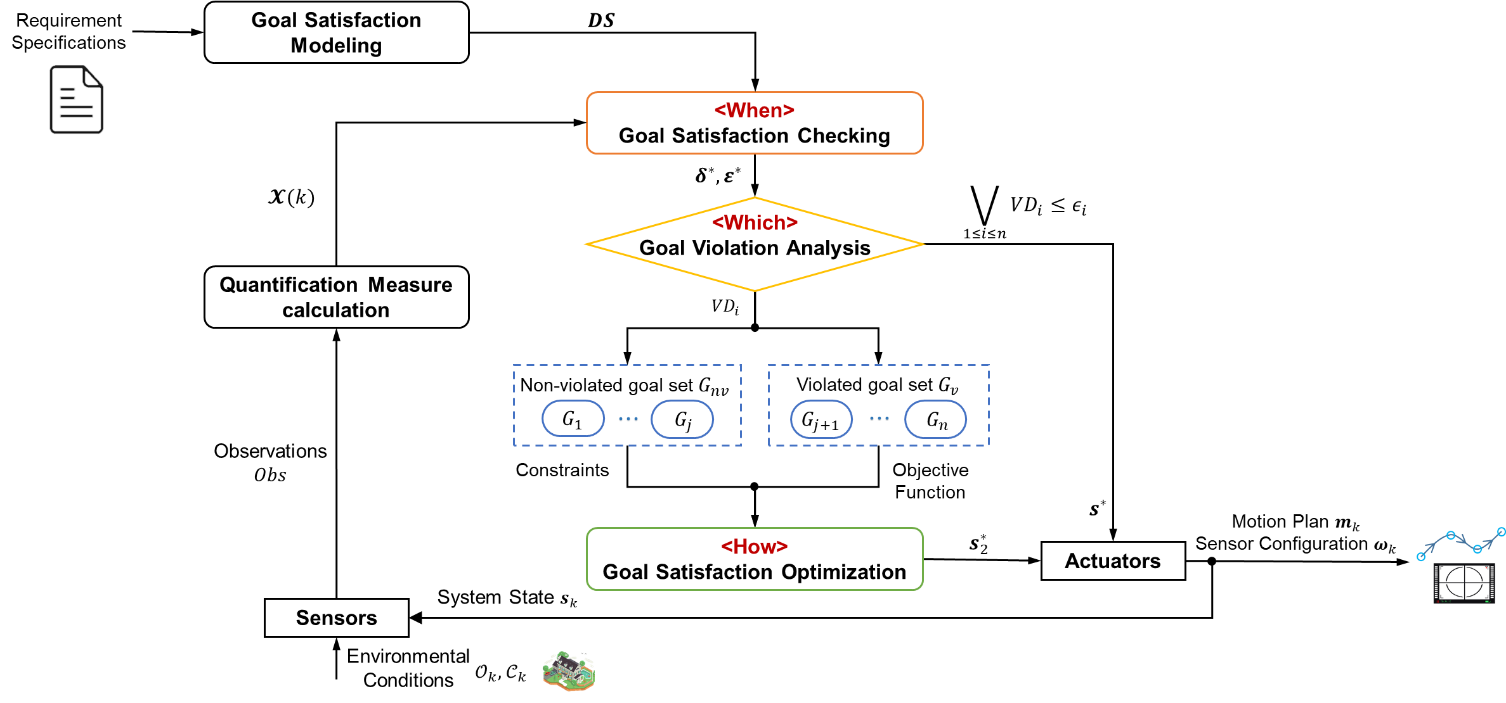
Approach Overview
Goal Satisfaction Checking
responsible for identifying the event of goal conflicts and violation based on a settled goal satisfaction model
Goal Violation Analysis
determines the sets of non-violated and violated goals
Goal Satisfaction Optimization generating a proper self-adaptation policy to maximize the satisfaction of violated goals while guaranteeing non-violated ones.

Slide 15
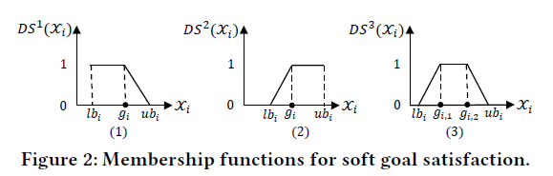


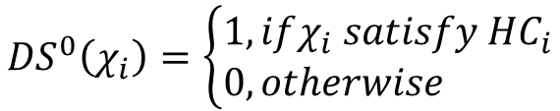

Goal satisfaction Modeling
Let $χ$ be the Quantification Measure (QM) for a goal in $G=HC⋃SG$. It is defined as a function of the system’s observations, i.e., $Ob$, which includes its states 𝑠 and the detected environmental conditions ($𝒪,𝒞$). Its value at time instant 𝑘 is denoted as $χ_{i}(k)$ for the evaluation of the goal $G_{i}$
$${DS}^{0}\left(χ_{i}\right)=\left\{\begin{aligned}1,&ifχ_{i} satisfy {HC}_{i} \\ 0,&otherwise\end{aligned}\right.$$
$${DS}^{0}=\{{DS}^{0}\left(χ_{i}\right)\}$$
$$DS=\{{DS}^{0},{DS}^{1},{DS}^{2},{DS}^{3}\}$$
It is expected that: $∀G_{i}∈G, {DS}^{j}\left(χ_{i}\right)≡1,j∈\{0,1,2,3\}$

Slide 16
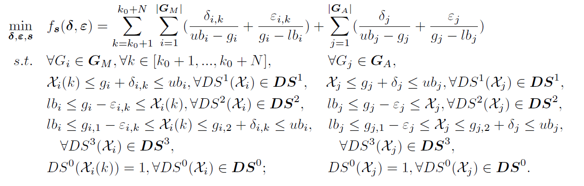
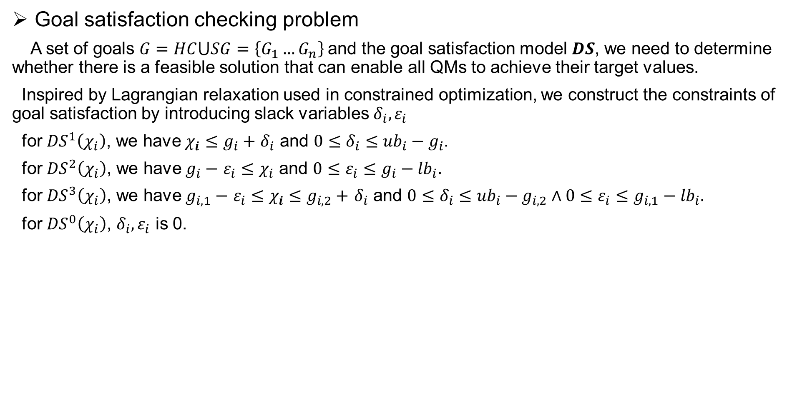
Goal satisfaction checking
Goal satisfaction checking problem
A set of goals $G=HC⋃SG=\left\{G_{1}…G_{n}\right\}$and the goal satisfaction model $DS$, we need to determine whether there is a feasible solution that can enable all QMs to achieve their target values.
Inspired by Lagrangian relaxation used in constrained optimization, we construct the constraints of goal satisfaction by introducing slack variables $δ_{i},ε_{i}$
for ${DS}^{1}\left(χ_{i}\right)$, we have $χ_{i}$ $≤g_{i}+$ $δ_{i}$ and $0≤δ_{i}≤{ub}_{i}−g_{i}$.
for ${DS}^{2}\left(χ_{i}\right)$, we have $g_{i}−$ $ε_{i}≤χ_{i}$ and $0≤ε_{i}≤g_{i}−{lb}_{i}$.
for ${DS}^{3}\left(χ_{i}\right)$, we have $g_{i,1}−$ $ε_{i}≤χ_{i}$ $≤g_{i,2}+$ $δ_{i}$ and $0≤δ_{i}≤{ub}_{i}−g_{i,2}∧0≤ε_{i}≤g_{i,1}−{lb}_{i}$.
for ${DS}^{0}\left(χ_{i}\right)$, $δ_{i},ε_{i}$ is 0.

Slide 17
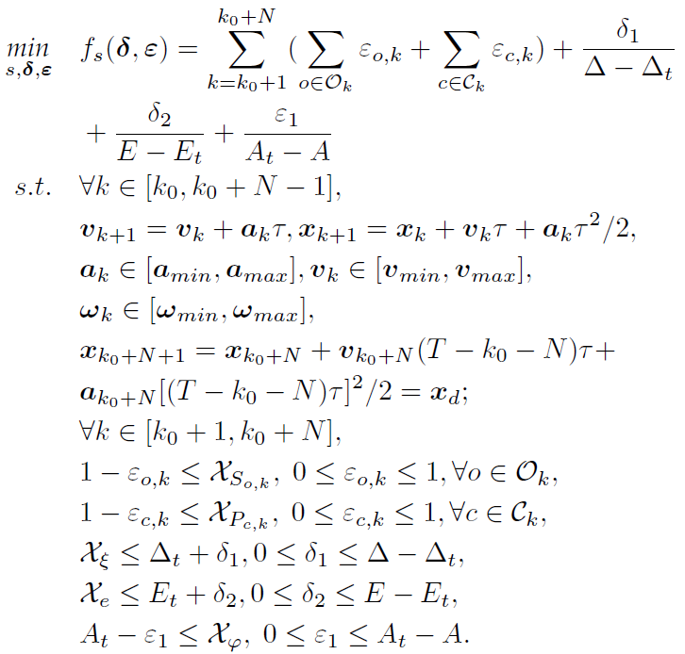

Goal satisfaction checking
UAV scenario
Suppose the sensing range is 𝑙 in the sense that only the obstacles and private regions whose distances to the UAV are not larger than 𝑙 can be detected. At the current instant $k_{0}$, the UAV needs
to plan its motions 𝒎 and sensor configuration 𝝎 for the following consecutive 𝑁 time steps, where $N≤\left\lfloor \frac{l}{v_{max}τ}\right\rfloor$

Slide 18
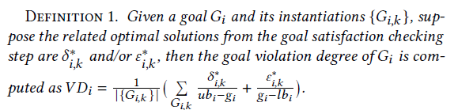
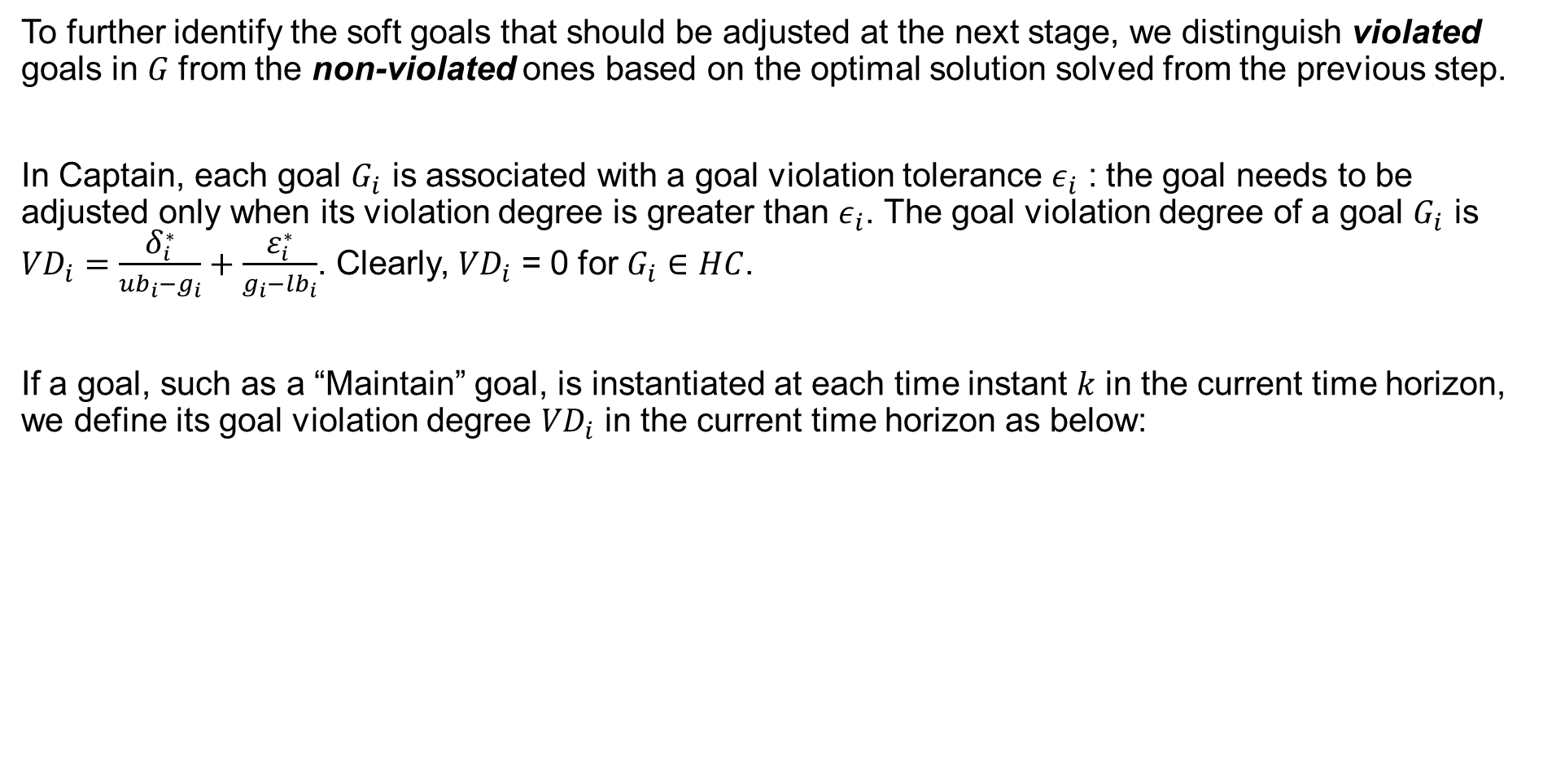
Goal Violation Analysis
To further identify the soft goals that should be adjusted at the next stage, we distinguish violated goals in 𝐺 from the non-violated ones based on the optimal solution solved from the previous step.
In Captain, each goal $G_{i}$ is associated with a goal violation tolerance ${\text{ε}}_{i}$ : the goal needs to be adjusted only when its violation degree is greater than ${\text{ε}}_{i}$. The goal violation degree of a goal $G_{i}$ is ${VD}_{i}=\frac{{\text{δ}}_{i}^{∗}}{{ub}_{i}−g_{i}}+\frac{{\text{ε}}_{i}^{∗}}{g_{i}−{lb}_{i}}$. Clearly, ${VD}_{i}$ = 0 for $G_{i}∈HC$.
If a goal, such as a “Maintain” goal, is instantiated at each time instant 𝑘 in the current time horizon, we define its goal violation degree ${VD}_{i}$ in the current time horizon as below:

Slide 19
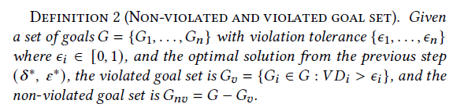
Goal Violation Analysis
Based on Definition 2, all of the hard constraints should belong to the non-violated goal set, otherwise there is a failure. The selection of violated goals depends on violation tolerances. The tolerances can be decided based on user preference or tails in the experiments.

Slide 20
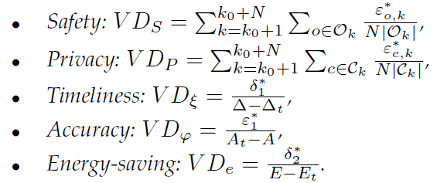
Goal Violation Analysis
UAV scenario

Slide 21
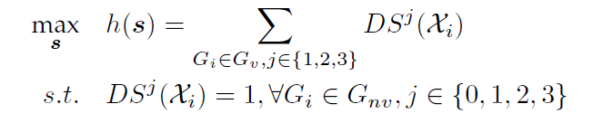

Goal Satisfaction Optimization
With analyzing results, goals in the violated goal set $G_{v}$ cannot be fully satisfied at their expected level under the current situation.
Thus, it is required to increase their satisfaction degree as much as possible, with the guaranteed satisfaction of other goals.
goal satisfaction optimization problem:
Through relaxing violated goals and transforming them into objective functions, the satisfaction of hard constraints and non-violated soft goals are guaranteed.

Slide 22
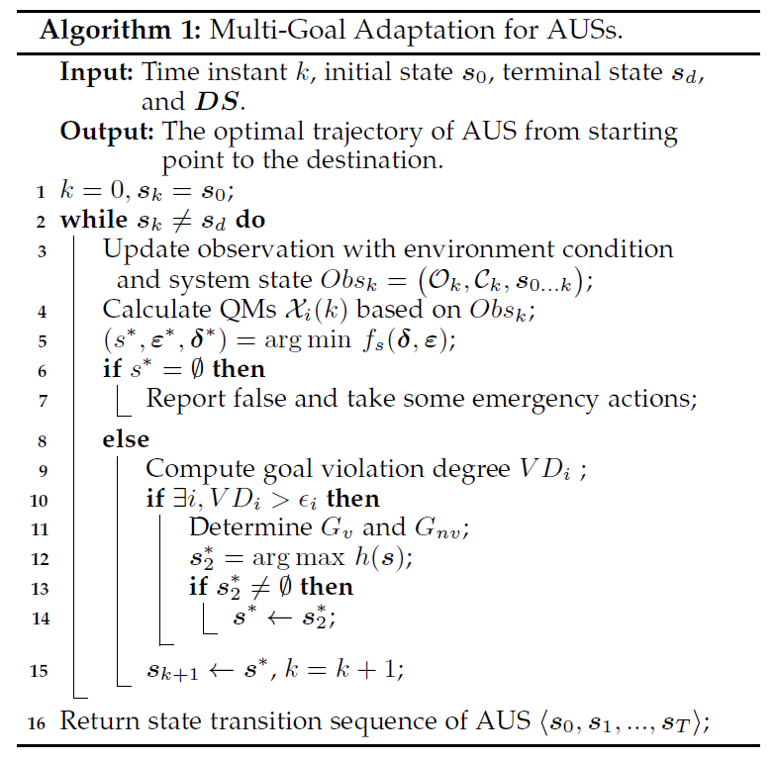
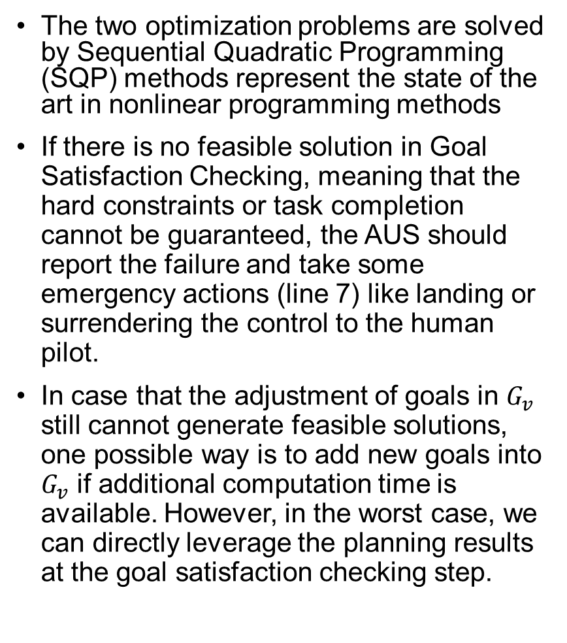
Algorithm
The two optimization problems are solved by Sequential Quadratic Programming (SQP) methods represent the state of the art in nonlinear programming methods
If there is no feasible solution in Goal Satisfaction Checking, meaning that the hard constraints or task completion cannot be guaranteed, the AUS should report the failure and take some emergency actions (line 7) like landing or surrendering the control to the human pilot.
In case that the adjustment of goals in $G_{v}$ still cannot generate feasible solutions, one possible way is to add new goals into $G_{v}$ if additional computation time is available. However, in the worst case, we can directly leverage the planning results at the goal satisfaction checking step.

Slide 23
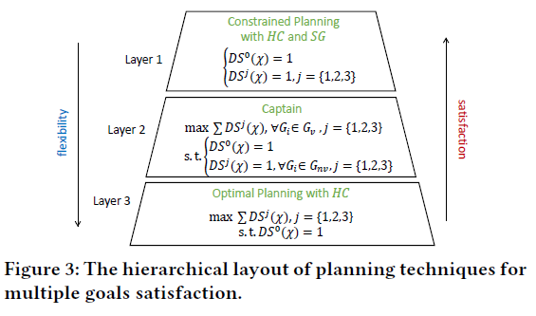
Advantages and Limitations of Captain
Optimality: Captain achieves a balance between flexibility and satisfactory by selecting violated soft goals to be optimized while keeping the other non-violated goals in their original formulation.
Flexibility: Captain is flexible to be compatible with other control-based methods. Such flexibility ensures the applicability of Captain in more situations with multiple goals.
Proactive detection of goal violations: Infeasibility of Eq. 5 implies violation of hard constraints or task failures.
Guaranteed real-time performance: The prediction horizon can be tuned according to the computational capability of the system.

Slide 24
4
Experimental Evaluation

Slide 25
Experimental Evaluation
We evaluated Captain in two AUS scenarios using MATLAB, and also implemented it on a real UAV (DJI Matrice 100). We evaluated the effectiveness, robustness, scalability and real-time performance of Captain. Our experiments focus on the following questions:
RQ1. (Effectiveness): Can Captain detect and solve goal conflicts, and provide optimal adaptation solutions at runtime?
RQ2. (Robustness): Can Captain handle different types of uncertainties at runtime?
RQ3. (Scalability): How is the scalability of Captain in large environment scales abstracted from real environment?
RQ4. (Generality) Can Captain be generalized to other AUSs in different application scenarios?
RQ5. (Performance): What is the real-time overhead of Captain?

Slide 26
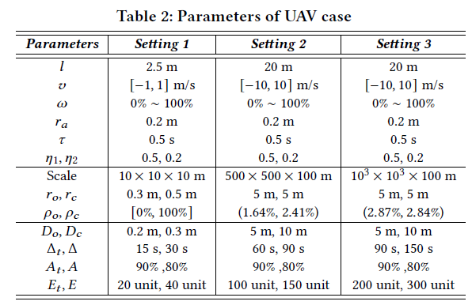
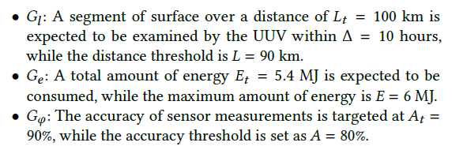
Evaluation Scenarios and Setup
For simulation, we implemented a simulator based on MATLAB 2019b on a desktop equipped with Intel(R) Core(TM) i7-7700U CPU@3.60GHz and 32GB RAM. The constructed optimization problems are solved by the Optimization Toolbox of MATLAB. Captain is compared with AMOCS-MA, the state-of-the-art control-based adaptation method for multiple software goals. We also compared the results of Captain with those from the Goal Satisfaction Checking, which only considers the minimization of goal violation of all soft goals. We denoted the latter one as GSlack.
UAV Delivery Scenario
UUV Oceanic Surveillance
DJI Matrice 100 UAV Scenario

Slide 27
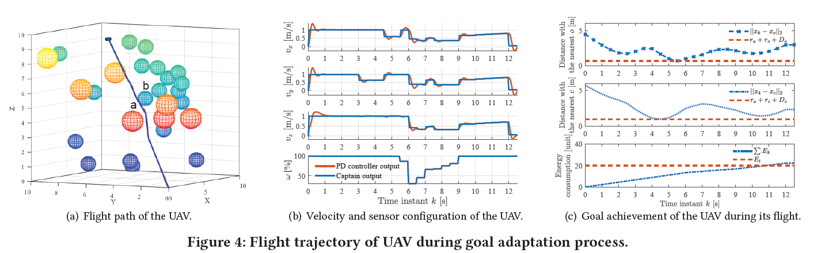
RQ1. Effectiveness
UAV case

Slide 28
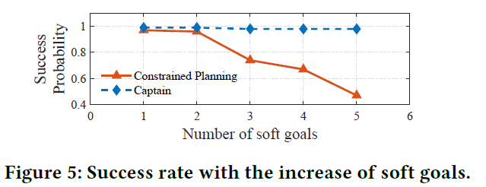
RQ1. Effectiveness
UAV case
Captain is effective in planning proper and optimal adaptation solutions at runtime to detect and solve goal conflicts and violations.

Slide 29
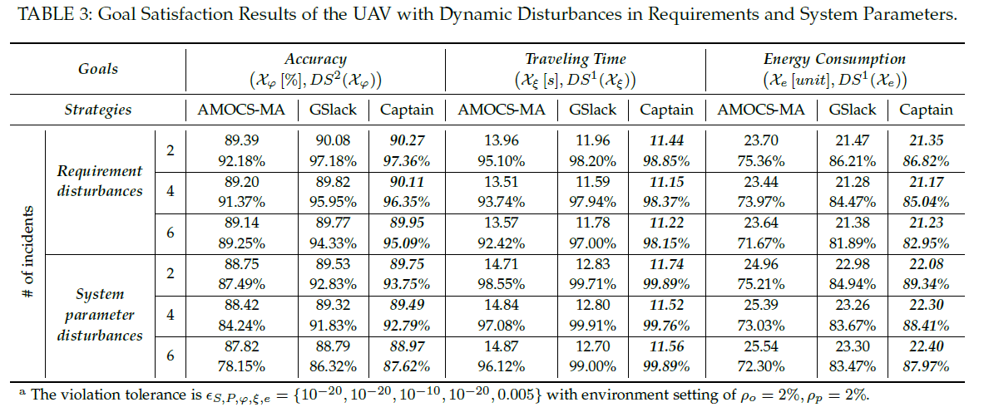
RQ2. Robustness
UAV case

Slide 30
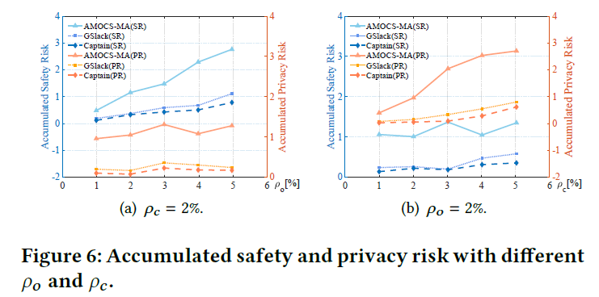
RQ2. Robustness
UAV case
Captain is robust against different types of uncertainties and guarantees better performance in goal satisfaction.

Slide 31
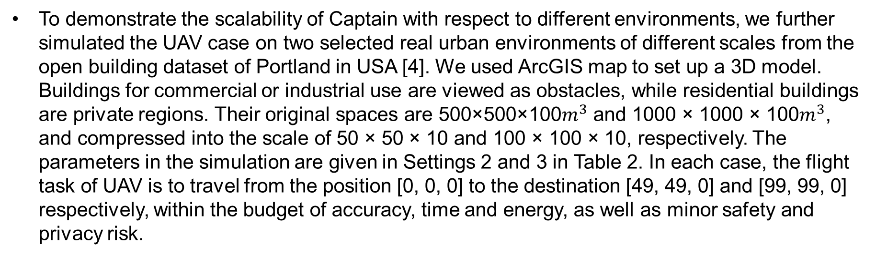
RQ3. Scalability
To demonstrate the scalability of Captain with respect to different environments, we further simulated the UAV case on two selected real urban environments of different scales from the open building dataset of Portland in USA [4]. We used ArcGIS map to set up a 3D model. Buildings for commercial or industrial use are viewed as obstacles, while residential buildings are private regions. Their original spaces are 500×500×100$m^{3}$ and 1000 × 1000 × 100$m^{3}$, and compressed into the scale of 50 × 50 × 10 and 100 × 100 × 10, respectively. The parameters in the simulation are given in Settings 2 and 3 in Table 2. In each case, the flight task of UAV is to travel from the position [0, 0, 0] to the destination [49, 49, 0] and [99, 99, 0] respectively, within the budget of accuracy, time and energy, as well as minor safety and privacy risk.

Slide 32
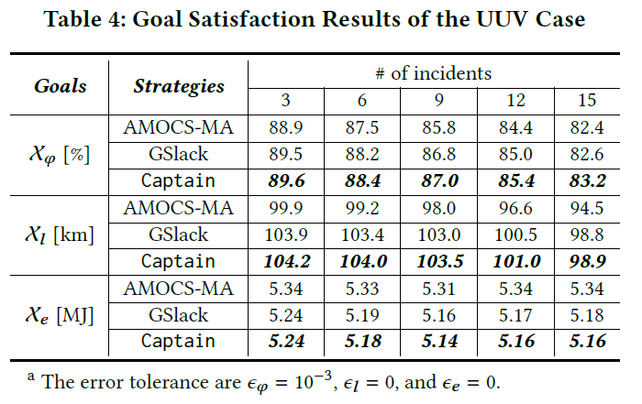
RQ4. Generality
Generality with UUV case
Captain can be generalized into different AUS applications and scenarios.

Slide 33
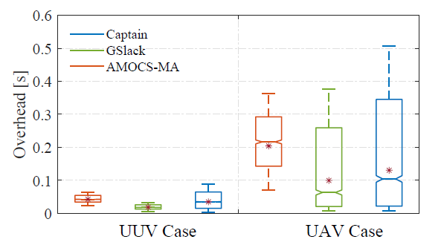
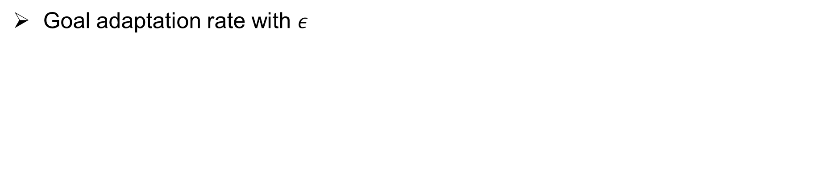
RQ5. Runtime Overhead
Goal adaptation rate with $ε$
the gap of average computation time between AMOCS-MA and Captain is about 7 ms (0.0423 s versus 0.0344 s) in the UUV case, and 70 ms (0.2039 s versus 0.1301 s) in the UAV case. This is because AMOCS-MA considers the optimization of all goals while Captain only considers the determined violated goals. So AMOCS-MA requires more computations especially when there are more goals to be considered.

Slide 34
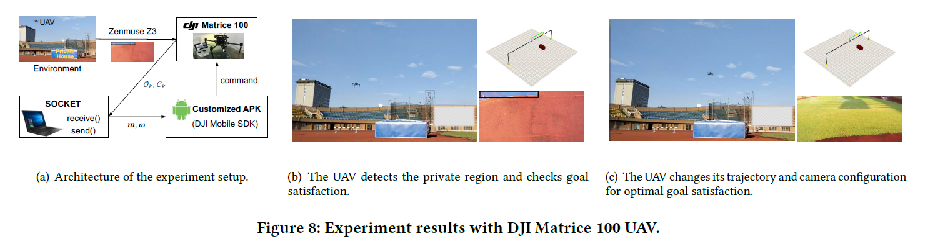
Implementation on a Real UAV
Captain is deployed on a Lenovo laptop which can receive the environment contexts from the onboard camera and generate the optimal motion plan. Then the optimal motion plan is sent to the DJI Matrice 100 via the Android application developed with the DJI mobile SDK on a mobile phone.
More details of experiments can be found at: https://fse2020captain.github.io/.

Slide 35
Threats to Validity
Construct validity
Internal validity
Captain requires that goals can be assessed or quantified, which may not be easy for all attributes.
More evaluations of different AUSs with more requirements are needed to validate Captain in the future.
The main limitation of the optimal control is that the convergent speed is sensitive to frequent changes and the initial values set to solve the problem.
In the future, we plan to try machine learning methods to generate high-quality initial solutions.
External validity
There are other uncertainties (e.g., weather, human in-the-loop) that can affect Captain and make the goal satisfaction models more complex.
We plan to evaluate Captain under scenarios with more types of uncertainties.

Slide 36
Limitation and Potential Mitigation
Choice of violation tolerances
Choice of optimization methods
The selection of violated goals in Captain is dependent on the violation tolerances The values cannot be too high either, otherwise it would filter a lower number of goals and result in no feasible solution again in the following optimization step. In experiments, we had to determine these values through trial-and-error.
There is a risk that the solution falls into a local optimum for SQP optimizer
Revised SQP method, heuristic algorithms for global optimum
Choice of prediction horizons
Considering that some qualities of AUS software may not change drastically (e.g., energy consumption), they are not required to be checked frequently
A two-layer hierarchical MPC approach. The first layer utilizes long discrete time steps and is used to monitor goals with slowly changing attributes (energy consumption), while the second layer utilizes short discrete time steps and is used to monitor goals with more frequently changing attributes (e.g., safety).

Slide 37
5
Related Work

Slide 38
Requirement Monitoring
Existing methods
Formalize requirements to be checked at runtime to detect deviations, e.g., Athena leverages utility functions for measuring the satisfaction and satisficement of goals at run time based on goal model[3].
Analyze traces of system execution and data logs, violations of assumptions and constraints can be detected, e.g., ACon uses a feedback loop and data-mining to detect inconsistent requirements affected by run-time uncertainty[4].
Limits
The focus of existing requirement monitoring approaches is mainly on detecting violations of expected behaviors, while the diagnosis of root causes of goal violation and countermeasures are limited.
In Captain, conditions conducive to goal violation are figured out proactively through Goal Satisfaction
Checking. Thus, the AUS is aware of when and which goals are likely to be violated and able to find out appropriate solutions.

Slide 39
Runtime Management of Goals
Existing methods
Based on modular and generic goal model
Utilizes control theory to realize the dynamic goal management process
Limits
Follow User-defined preference or hand-specified rules
System is statically designed to satisfy a fixed set of system goals
In Captain, conditions conducive to goal violation are figured out proactively through Goal Satisfaction
Checking. Thus, the AUS is aware of when and which goals are likely to be violated and able to find out appropriate solutions. The soft goal assumed to be violated are not viewed as constraints to be totally satisfied. Instead, they are transformed into an objective function for dynamic optimization, which becomes more flexible for many-objective optimization problems

Slide 40
Goal-Driven Adaptation
Existing methods
In the wave goal-driven adaptation, the textual language RELAX is invented to express requirements in terms of uncertainty[6], and incorporated into goal models for self-adaptive system using KAOS[7].
AutoRELAX[8] targets at figure out the relaxed goal model at the least number of relaxed goals and adaptation cost online. A similar approach introduces FLAGS[9] for mitigating requirements uncertainty by extending goal model with adaptive goals, allowing requirements to be partially satisfied and the system possesses the ability of fault tolerance.
Limits
The RELAX operator is only applied to specify the extent to which a non-invariant functional requirement may become temporarily unsatisfied at runtime.
The selection and adjustment of goals-to-adapt are made based on predefined rules and preferences.
In our approach, the relaxation of soft goals should be enforced such that only the goals which will be violated in the near future are selected and adjusted.

Slide 41
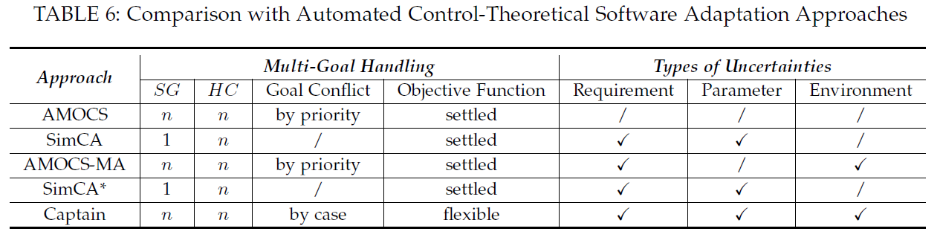
Control-Based Adaptation
Existing methods
Strategies for the design of a control theoretical adaptive system have been proposed since the Push-Button Methodology (PBM) [12] —— single goal
Multiple goals are satisfied through a system of cascaded controllers[13] —— preference, sub-optimal solutions
SimCA[2] and its variants SimCA* [14]—— cannot handling conflicting goals
AMOCS-MA[1] —— low real-time performance
Captain optimizes overall satisfaction multiple goals, which may conflict with others, in the premise of the guarantees of hard constraints and task completion.

Slide 42
6
Conclusions and Future work

Slide 43
Conclusions and Future work
Conclusions
We present a novel control-based approach, Captain, to dynamically adjusting multiple and conflicting goals for AUSs.
It enables AUSs to respond to changes of environmental conditions, requirements and system parameters at real-time.
The effectiveness and efficiency of Captain are evaluated on two kinds of simulation scenarios and a real UAV.
Experiments show that Captain outperforms the state-of-art controlled based self-adaptive methods with higher flexibility, optimality and lower overhead.
Future work
study methods to further improve the efficiency of violated goal identification and reduce the failure rate at the Goal Satisfaction Optimization step.
handle more complex scenarios of AUSs with additional requirements.

Slide 44
Reference
Maggio M, Papadopoulos A V, Filieri A, et al. Automated control of multiple software goals using multiple actuators[C]//Proceedings of the 2017 11th joint meeting on foundations of software engineering. ACM, 2017: 373-384.
Shevtsov S, Weyns D. Keep it simplex: Satisfying multiple goals with guarantees in control-based self-adaptive systems[C]//Proceedings of the 2016 24th ACM SIGSOFT International Symposium on Foundations of Software Engineering. ACM, 2016: 229-241.
Ramirez A J, Cheng B H C. Automatic derivation of utility functions for monitoring software requirements[C]//International Conference on Model Driven Engineering Languages and Systems. Springer, Berlin, Heidelberg, 2011: 501-516.
Knauss A, Damian D, Franch X, et al. ACon: A learning-based approach to deal with uncertainty in contextual requirements at runtime[J]. Information and software technology, 2016, 70: 85-99.
Vierhauser M, Cleland-Huang J, Bayley S, et al. Monitoring cps at runtime-a case study in the uav domain[C]//2018 44th Euromicro Conference on Software Engineering and Advanced Applications (SEAA). IEEE, 2018: 73-80.
Whittle J, Sawyer P, Bencomo N, et al. RELAX: a language to address uncertainty in self-adaptive systems requirement[J]. Requirements Engineering, 2010, 15(2): 177-196.
Whittle J, Sawyer P, Bencomo N, et al. Relax: Incorporating uncertainty into the specification of self-adaptive systems[C]//2009 17th IEEE International Requirements Engineering Conference. IEEE, 2009: 79-88.
Fredericks E M, DeVries B, Cheng B H C. AutoRELAX: automatically RELAXing a goal model to address uncertainty[J]. Empirical Software Engineering, 2014, 19(5): 1466-1501.
Baresi L, Pasquale L, Spoletini P. Fuzzy goals for requirements-driven adaptation[C]//2010 18th IEEE International Requirements Engineering Conference. IEEE, 2010: 125-134.
Degiovanni R, Ricci N, Alrajeh D, et al. Goal-conflict detection based on temporal satisfiability checking[C]//Proceedings of the 31st IEEE/ACM International Conference on Automated Software Engineering. ACM, 2016: 507-518.
Degiovanni R, Castro P, Arroyo M, et al. Goal-conflict likelihood assessment based on model counting[C]//2018 IEEE/ACM 40th International Conference on Software Engineering (ICSE). IEEE, 2018: 1125-1135.

Slide 45
Reference
Filieri A, Hoffmann H, Maggio M. Automated design of self-adaptive software with control-theoretical formal guarantees[C]//Proceedings of the 36th International Conference on Software Engineering. ACM, 2014: 299-310.
Filieri A, Hoffmann H, Maggio M. Automated multi-objective control for self-adaptive software design[C]//Proceedings of the 2015 10th Joint Meeting on Foundations of Software Engineering. ACM, 2015: 13-24.
Shevtsov S, Weyns D, Maggio M. SimCA*: A control-theoretic approach to handle uncertainty in self-adaptive systems with guarantees[J]. ACM Transactions on Autonomous and Adaptive Systems (TAAS), 2019, 13(4): 17.

